Slide 1

EPIC IPWN: REVIEWING NSO GROUP'S PEGASUS SPYWARE
Etizaz Mohsin | Owais Mehtab

Slide 2
Speakers Introduction
Etizaz Mohsin
Senior Security Consultant
Speaker @ Hitcon, 44CON, CONFidence, Sector, Deepsec, Grehack, Hacktivity, Wild West Hackin Fest etc
Featured in Al Jazeera, Wired, TechCrunch etc
Linkedin: https://www.linkedin.com/in/aitezaz/
Owais Mehtab
Principal Security Consultant @ MDSec
Speaker @ Bsides
Linkedin: https://www.linkedin.com/in/owais-mehtab/

Slide 3



Cyber Weapons: The New ‘Arms Race’
“Lawful Intercept”

Slide 4
Pegasus Project
Worldwide investigation of NSO Group’s Pegasus exploitation
Collaboration of over 70 journalist from various media outlets
Amnesty International provided technical support for analysis
65+ devices analyzed (before publication)
Approximately 36-37 showed artifacts of Pegasus spyware targeting or infection
Over 80% of Apple Devices analyzed showed evidences of the NSO spyware
Amnesty International published tools (Mobile Verification Toolkit) and Indicator of compromises

Slide 5
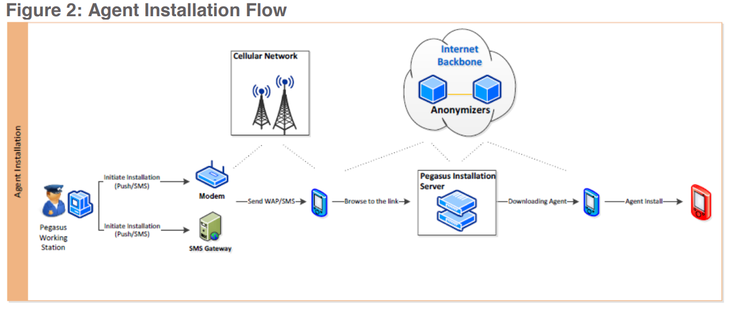
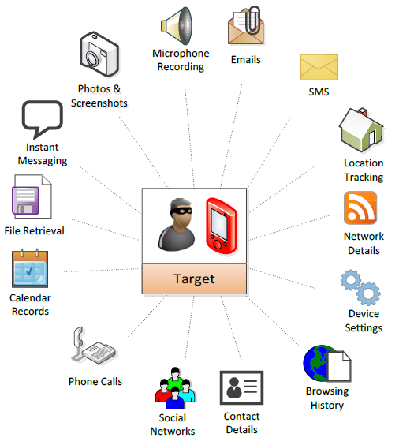
What is Pegasus
Pegasus is espionage software
Been developed by NSO Group since around 2010
Initial version focused on Blackberry

Slide 6
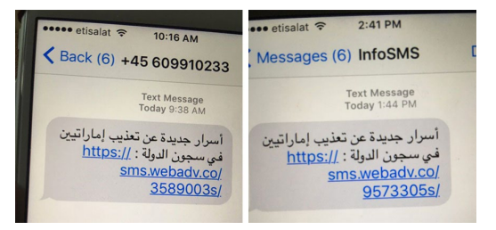
Pegasus In The Wild
Samples were first identified by Citizen Lab in 2016
UAE human rights defender was repeatedly targeted with exploit SMS messages
Notes:
Middle Eastern Human Rights Defender targeted with phishing links
Link contains exploit for safari
The Trident vulnerabilities used by NSO could have been weaponized against users of non iOS devices,
http://fb-accounts.com/1074139s/
http://unonoticias.net/3423768s/.
NSO group used 3 exploits to remotely jailbreak device
1 to get code execution from the browser - UAF
2 to get elevated access on the device the first exploit leaks memory address of kernel and the 2nd uses that information to execute code in privilege context.

Slide 7
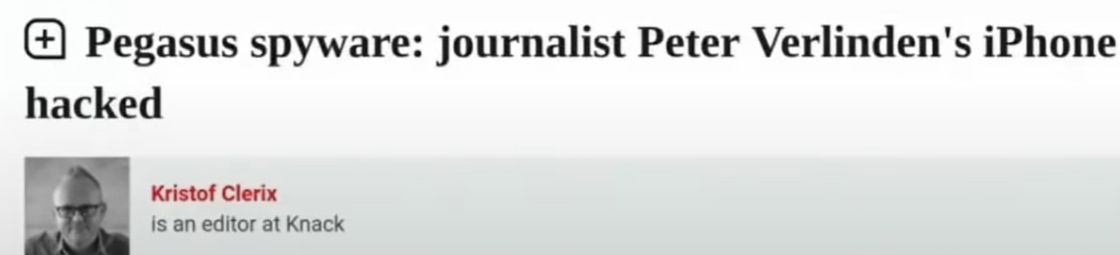
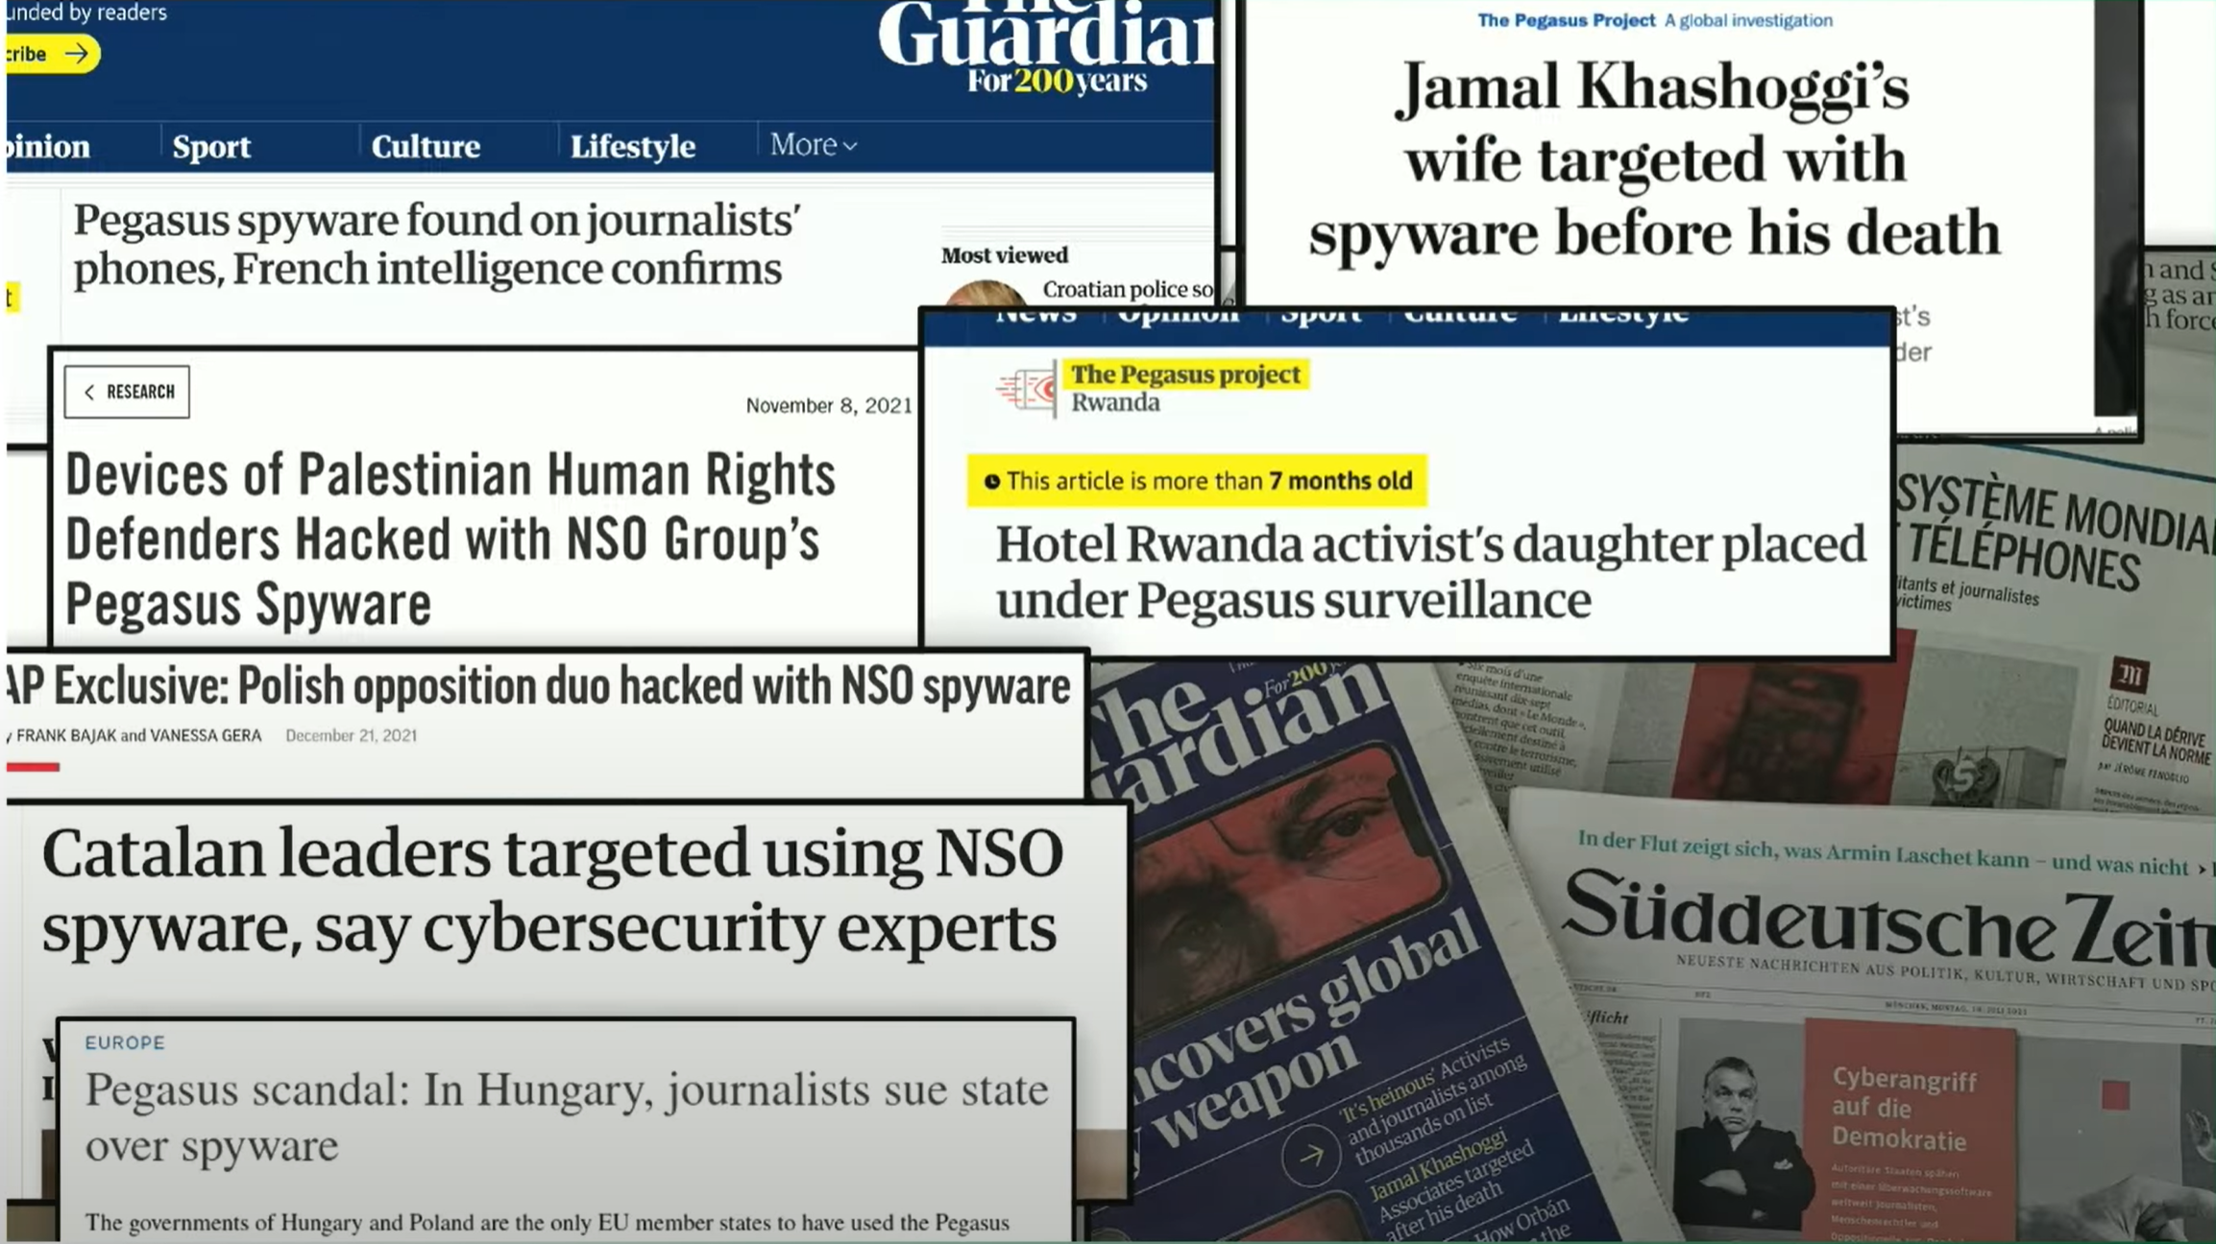

Slide 8
Zero-click Attacks
Interaction less but not remote
Packet Injection
Man in the Middle
Physical access to device
Remote but not interaction less
Click on a link
Install an app
Accept an invite

Slide 9
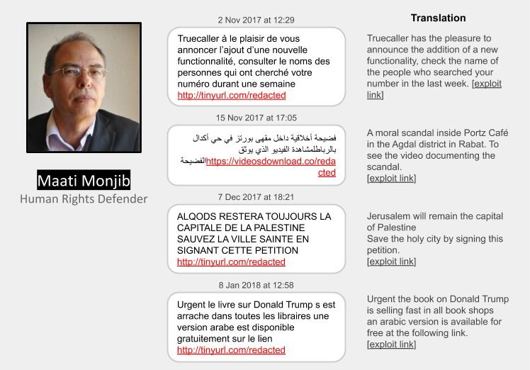
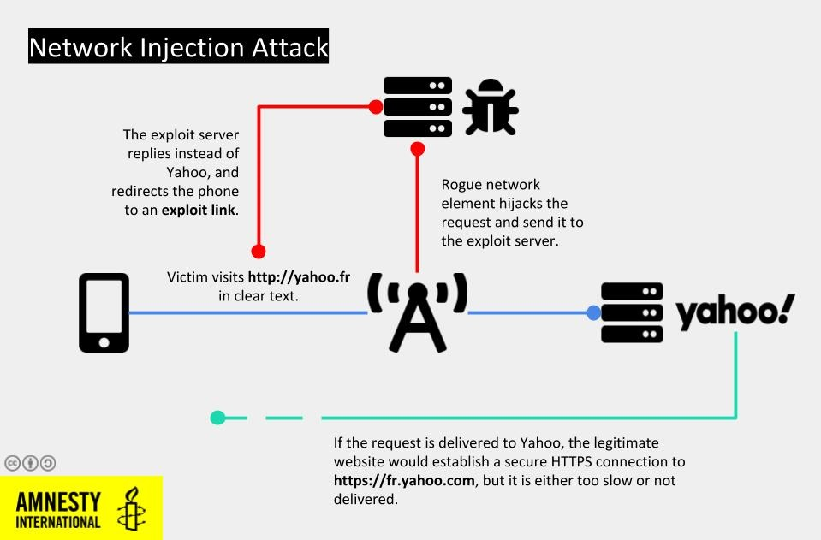
Pegasus Upping The Game In Morocco
Man in the Middle attack
Redirected clear text traffic of yahoo.fr to bun54l2b67.get1tn0w.free247downloads.com
Phishing links points to NSO attack infrastructure
Notes:
Classic MiTM attack link redirection when Maati Monjib was targeted
https://yahoo.fr -> https://bun54l2b67.get1tn0w.free247downloadscom:30495/szev4hz

Slide 10
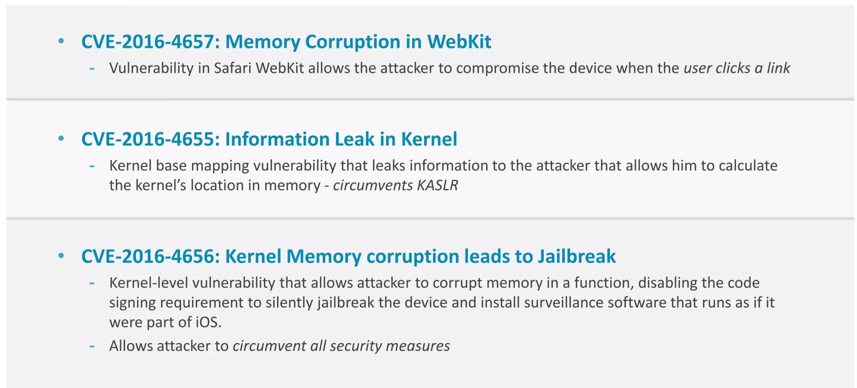
Browser Exploits (Trident)– 3 Zero Day iOS Vulnerabilities

Slide 11
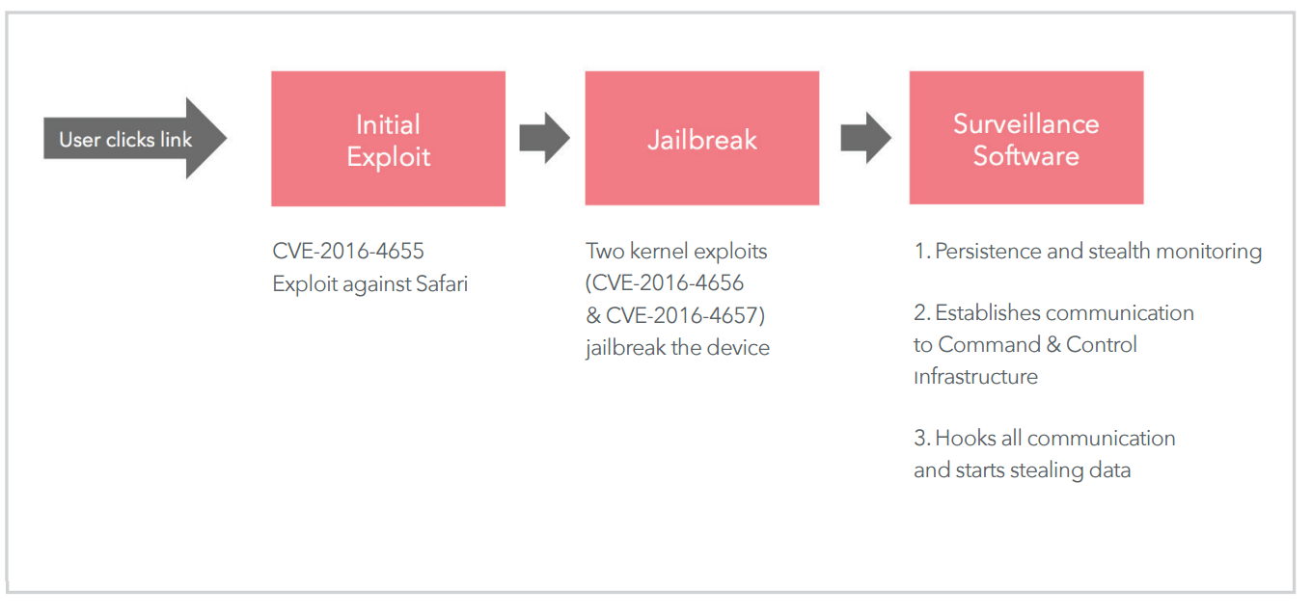
Browser Exploits (Trident)– 3 Zero Day iOS Vulnerabilities

Slide 12
Browser Exploits (Trident)– Safari Use After Free
UAF 101
Exploit code Allocates the Free-Ed Object
App Tries to Access Free-Ed Object
Redirects to Malicious Code
Notes:
Once the user clicks on the link
Safari opens the link and tries to render the page which in turn make use of webkit
The code tries to allocate an object that was free-ed

Slide 13
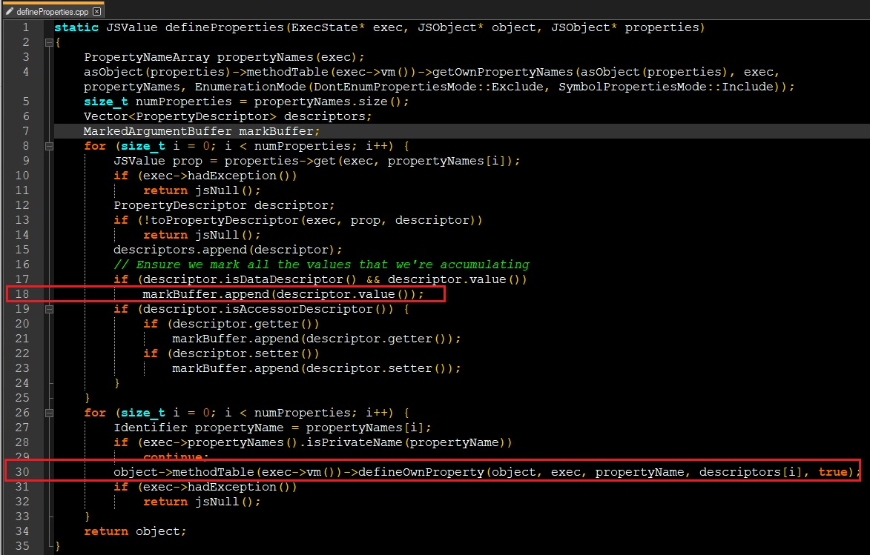
Browser Exploits (Trident)– Safari Use After Free
Notes:
Once the user clicks on the link
Safari opens the link and tries to render the page which in turn make use of webkit
define properties
can be used to modify existing object properties.
first loop checks for official property descriptor formatting
to make sure this reference to properties is not invalidated by GC markBuffer.append is used.
2nd loop runs after all the property groups have been validated
uses defineOwnProperty associate/tag property to target object
the problem here is the final property may be used to call user-defined method which may trigger gc this would result in any referenced object to be invalidated
How this can trigger gc and cause UAF we have to look into defineOwnProperty method

Slide 14
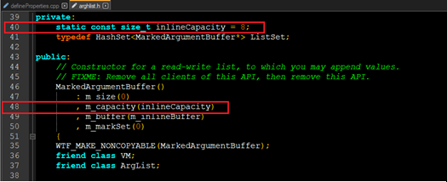
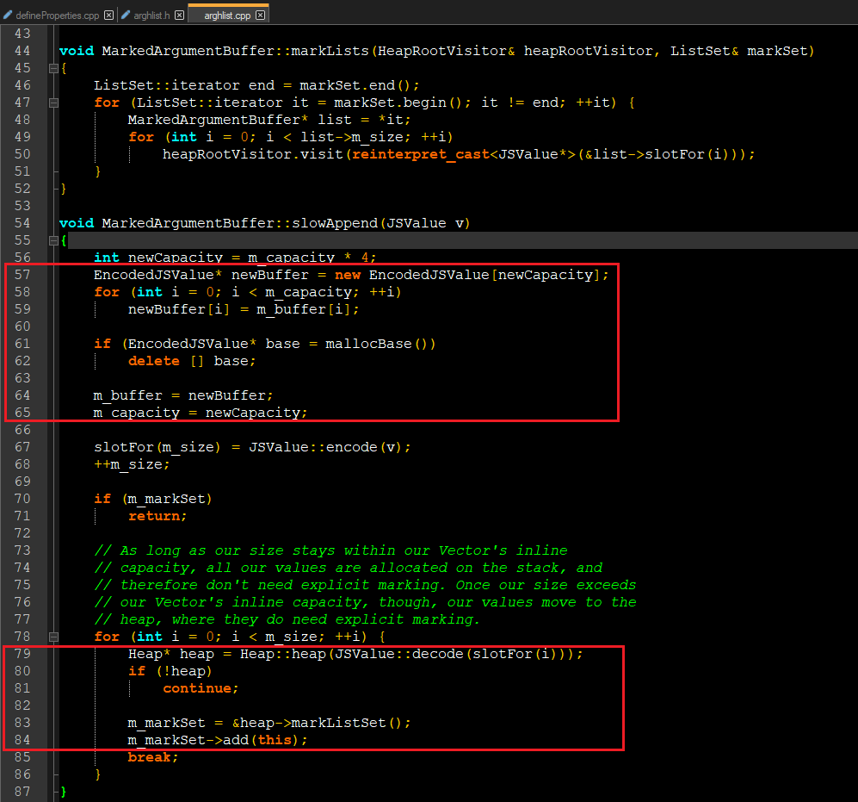
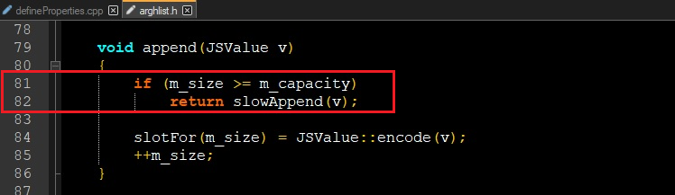
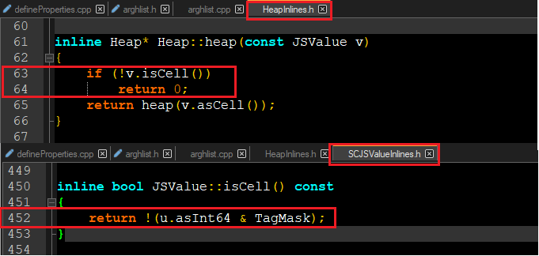
Browser Exploits (Trident)– Safari Use After Free
Notes:
markbuffer::append
first 8 objects are placed on stack
from 9th object are moved to heap without protection marking against gc automatically
Running slowappend will expand capacity
Problem here is slowappend is executed only once
When we look into slowappend function on line 57-65 it is basically moving data/objects from stack to heap
When we look into slowappend function on line 79-84 it is checking for heap context reference if not found it cannot mark the object to prevent from gc
To prevent objects from gc marklists is used
The heap context is evaluated by heap::heap method which calls iscell if that check fails we cannot acquire heap context and thus we cannot protect the object.

Slide 15
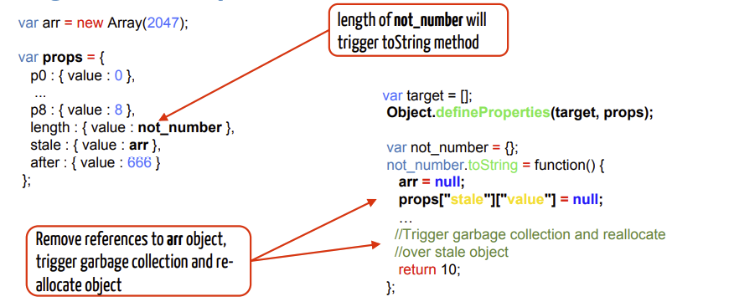
Browser Exploits (Trident)– Safari Use After Free
Strategy To Trigger Use After Free
Create 8 properties of type integer
Create 9th property as a String type to allow object to be deallocated by GC
Create sacrificial property
Setting string type data will eventually trigger GC that will deallocate the object
Create Fake Object
Win ! [Not so fast ☺]
Notes:
Create 8 simple properties
Create 9th property as not int or tagmask such as a string
https://info.lookout.com/rs/051-ESQ-475/images/pegasus-exploits-technical-details.pdf

Slide 16
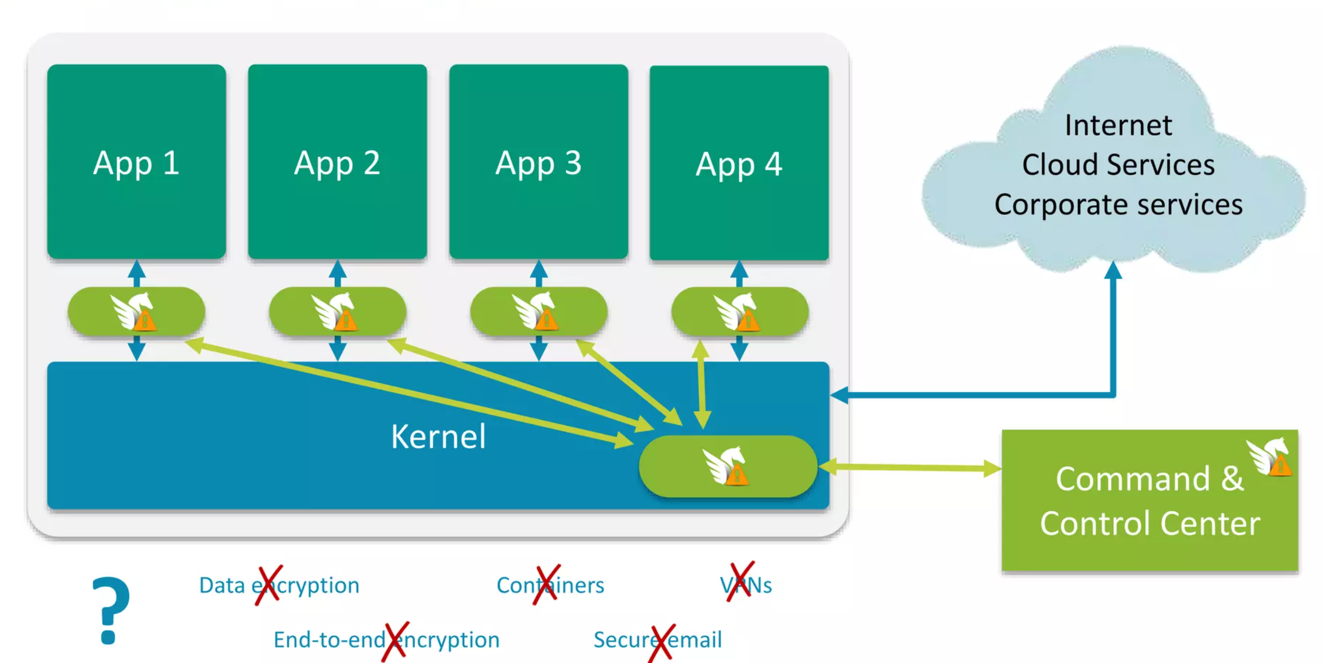
Browser Exploits (Trident)– 3 Zero Day iOS Vulnerabilities

Slide 17
Browser Exploits (Trident)– Kernel Exploitation Payload
The payload executed using Safari Use After Free contains two exploits
The first exploit code was used for leaking memory to bypass KASLR
The second exploit was another Use After Free in Kernel to get elevated access
All of this can be triggered from Safari (Sandbox)
Notes:
Mem Leak and LPE using kernel exploit

Slide 18
Browser Exploits (Trident)– Safari Use After Free
Mem Leak 101
Create Sacrificial Objects
Overflow into one of the object to change object size
Read Object
Place your Malicious Object before the Sacrificial Objects
Functions controlling variable size
Attacker Increases variable size
Read Variable
Size is controllable by attacker
Notes:
These are just two examples of how we can create memory leak, other possible ways to leak memory:
Format string

Slide 19
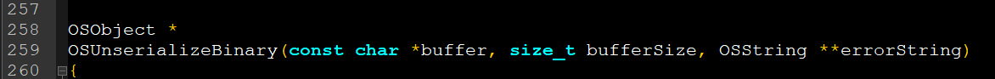
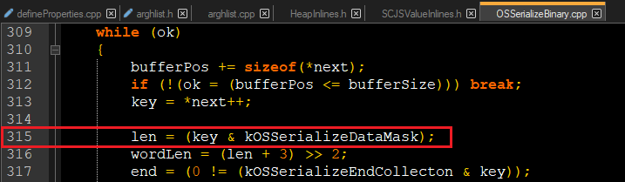
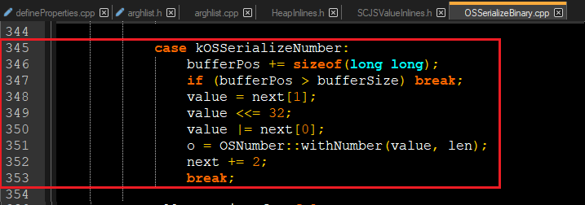
Browser Exploits (Trident)– Memory Leak
Notes:
Mem Leak and LPE using kernel exploit
Mem Leak is caused by OSUnserializedBinary which converts serialized data to kernel object
Mem Leak is caused by OSUnserializedBinary which calls withNumber
Notice how no length checks are performed on len and value variable

Slide 20
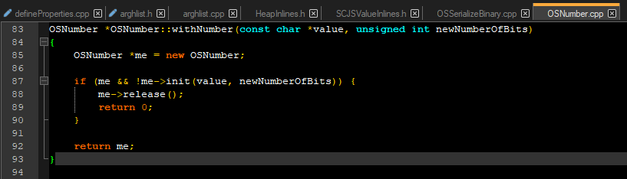
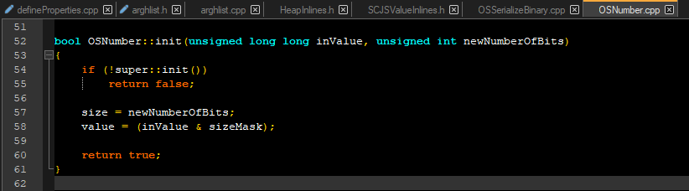
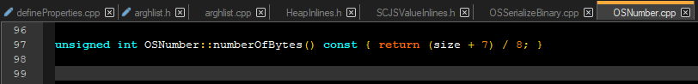
Browser Exploits (Trident)– Memory Leak
Notes:
Withnumber calls init and sends newNumberofBits as argument
And init sets that as size it is user controllable
Once the size is set it will be used in other methods of same object

Slide 21
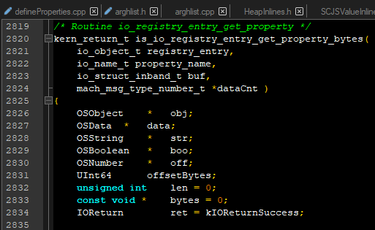
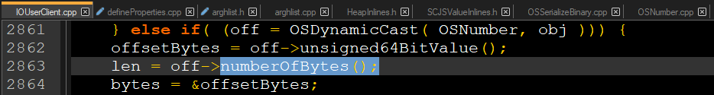
Browser Exploits (Trident)– Memory Leak
Notes:
Now we know we can control size value within the object next we need to find some kernel object that suite our needs

Slide 22
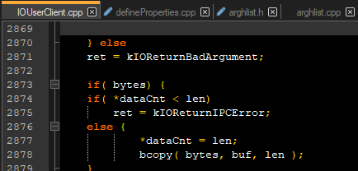
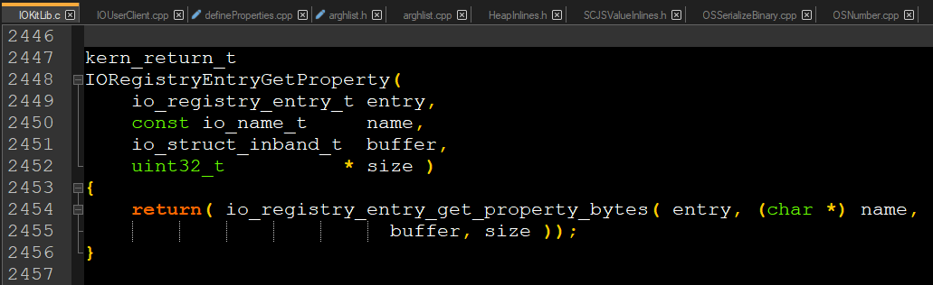
Browser Exploits (Trident)– Memory Leak
Notes:
is_io_registry_entry_get_property_bytes is ideal candidate as it calls It uses bcopy which returns kernel stack
but to call is_io_registry_entry_get_property_bytes we need to find method that can be called directly from userland
Now we need to find something that can call io_registry_entry_get_property_bytes
IORegistryEntryGetProperty can be called directly from sbx/sa

Slide 23
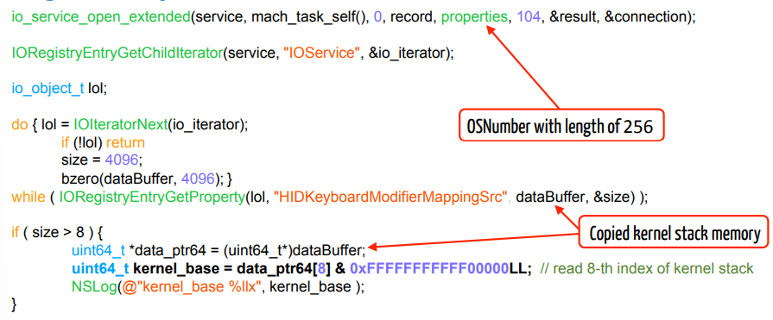
Browser Exploits (Trident)– Memory Leak
Strategy To Leak Kernel Memory
Create service with OSNumber Object with high number of bits
Extend service
Call IORegistryEntryGetProperty
Read Kernel memory address
Calculate base address by subtracting displacement
Notes:
Create service with high values of properties
Extend the service and call IORegisterGetProperty !
This will leak the address from kernel, find base address by relative difference

Slide 24
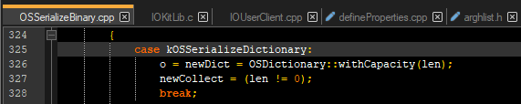
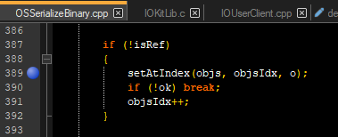
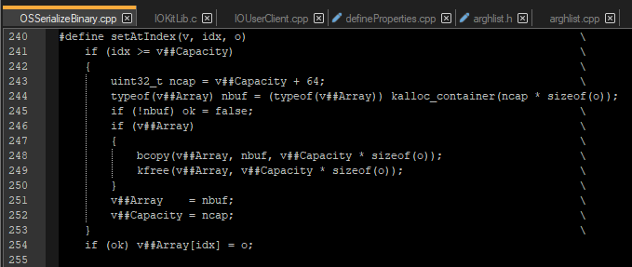
Browser Exploits (Trident)– Kernel Use After Free
Notes:
kOSSerializedObject allows us to create reference to already serialized object
It keep tracks of objects using setAtIndex and saves a pointer to object in the array

Slide 25
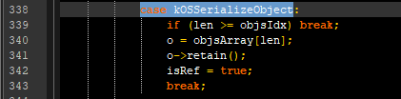

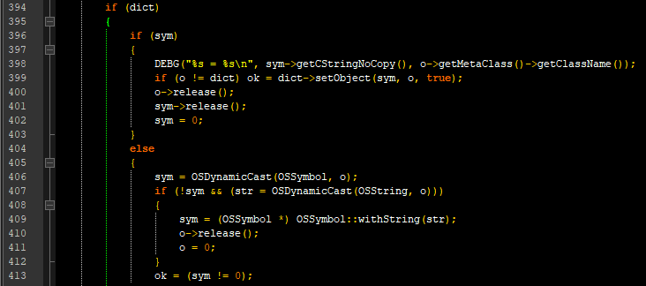
Browser Exploits (Trident)– Kernel Use After Free
Notes:
kOSSerializedObject allows us to create reference to already serialized object
It keep tracks of objects using setAtIndex

Slide 26
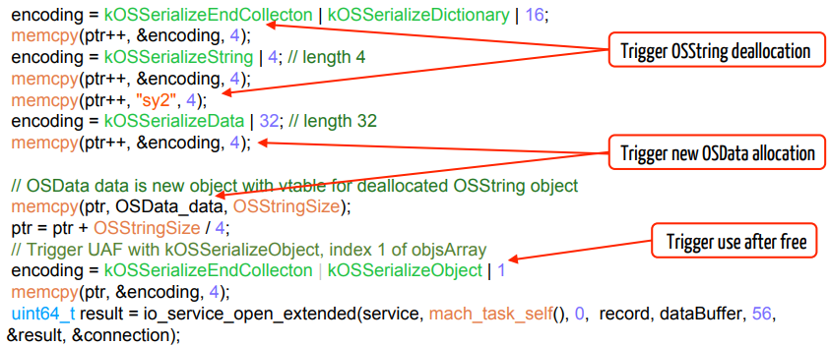
Browser Exploits (Trident)– Kernel Use After Free
Strategy To Trigger Use After Free
Trigger deallocation of vulnerable object of kOSSerializeDictionary
setAtIndex had already saved a reference pointer to object of deallocated object
Allocate fake/malicious object of same type
Trigger use of Malicious/Fake object
Reliable code execution as we have memory leak

Slide 27
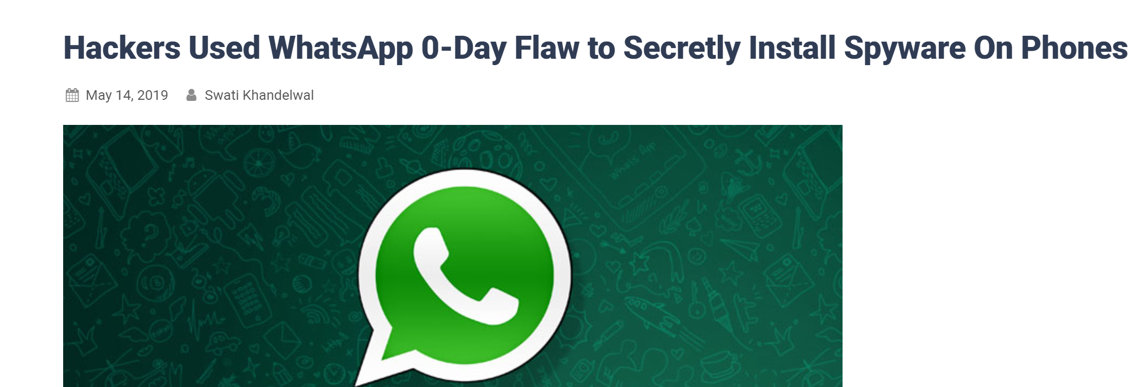
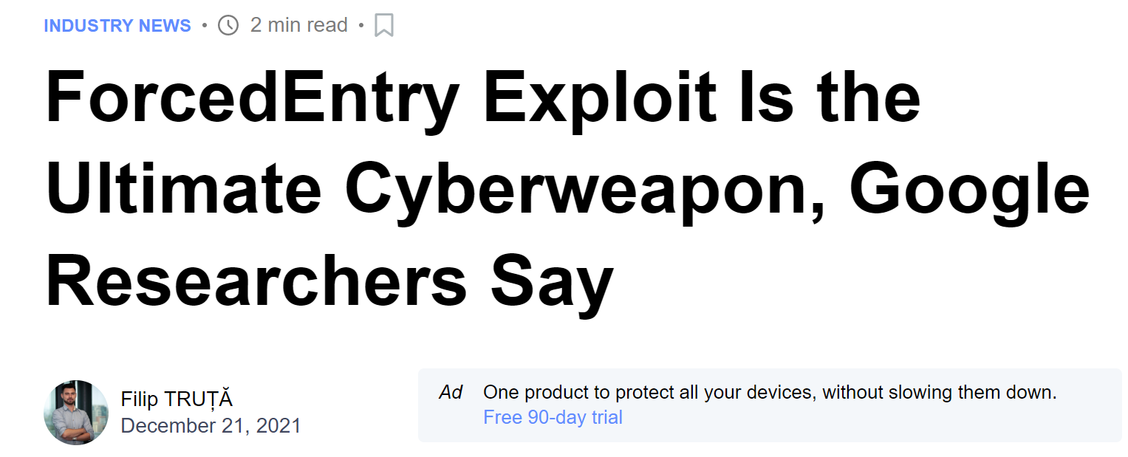
The Zero-Click – Remote and Interaction Less
No user interaction is required - exploit just works silently in the background
Even very technically savvy targets are unaware they are being targeted.
there is no way to prevent exploitation by a zero-click exploit; it's a weapon against which there is no defense.

Slide 28
Forensic Methodology to Detect Zero-Clicks
Lack of visibility on mobile devices. Attacks often go undetected.
It is difficult to perform forensic on mobile devices but no impossible
iPhones allow a significant amount of relevant data to be extracted in iPhone backups
Android devices are less consistent. Generally, much less forensically useful data is available on Android. Some differences between devices OEMs and software versions
Lack of Public tools for consensual mobile forensics

Slide 29
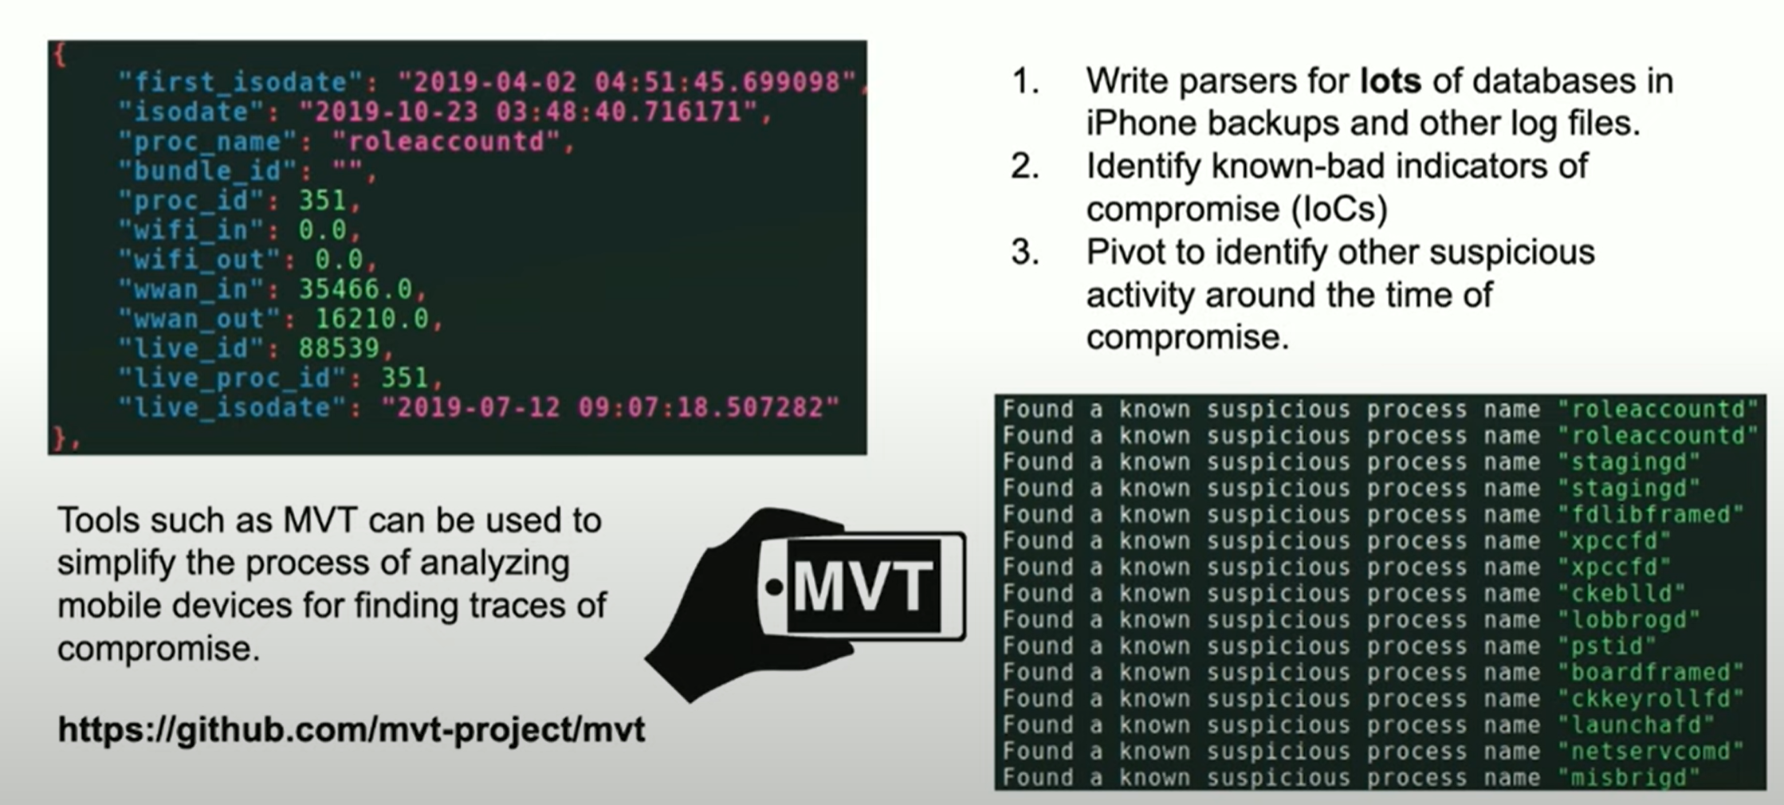
Forensic Methodology to Detect Zero-Clicks

Slide 30
Exploit Arsenal - 6 iOS zero-clicks + 1 Android zero-click
iOS 10 Goldengate
iOS 11 Voice-over-WiFi Thumper exploit
iOS 13 PhotoStream
iOS 12 iMessage NSUnarchive Deserialization CVE-2019-8646
iOS 13 KISMET (IMTranscoderAgent)
iOS 14 ForcedEntry / Megalodon
Android WhatsApp

Slide 31
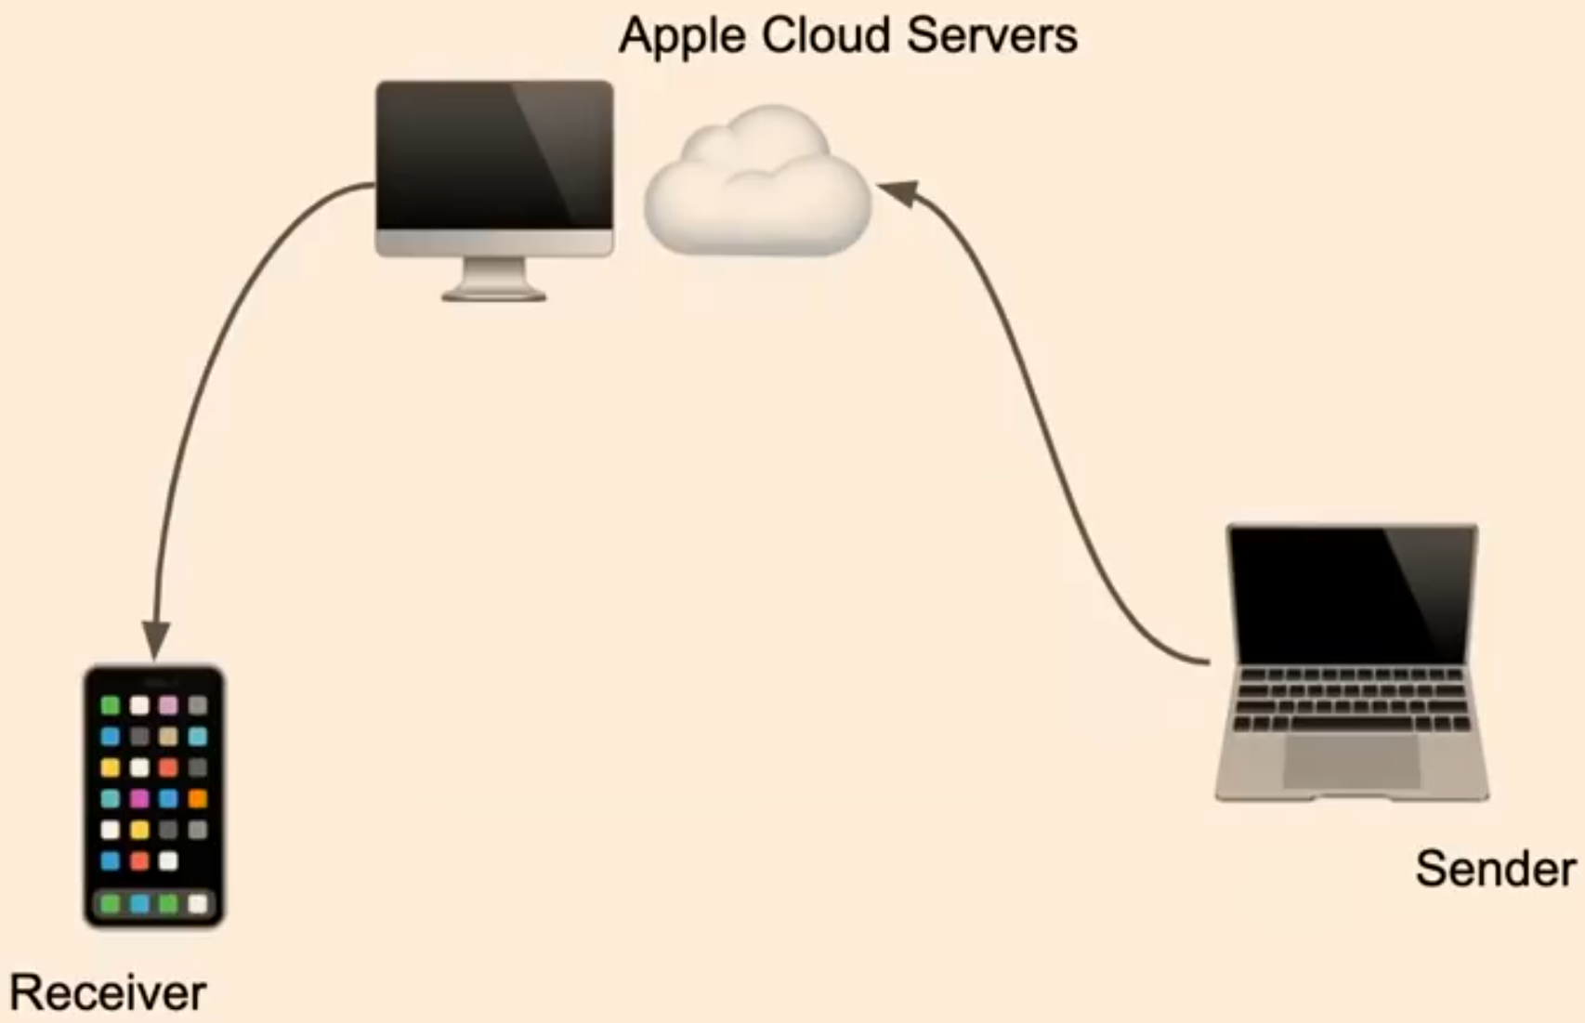
iMessage Architecture
Messaging service by Apple
Enabled by default when signed into iPhone with an apple account
Anyone can send messages
imagent process is important as it is handling iMessages

Slide 32
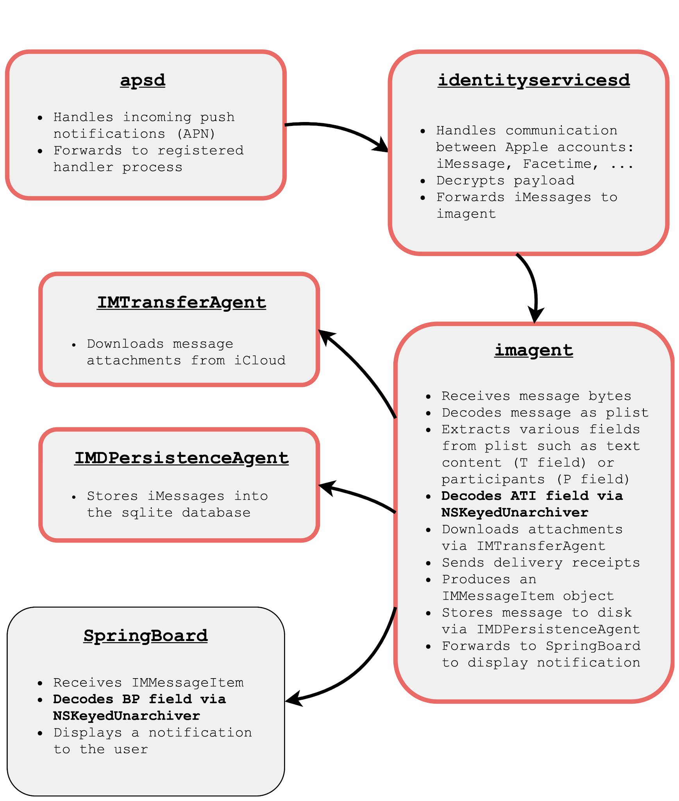
iMessage Architecture

Slide 33
Memory Corruption
ASLR Bypass
PAC Bypass
Unsandboxed Code Execution

Slide 34
iMessage Data Format
{
gid = "008412B9-A4F7-4B96-96C3-70C4276CB2BE";
gv = 8;
p = (
"mailto:sender@foo.bar",
"mailto:receiver@foo.bar"
);
pv = 0;
r = "6401430E-CDD3-4BC7-A377-7611706B431F";
t = "BLACKHAT MEA";
v = 1;
x = "<html><body>Hello BLACKHAT MEA</body></html>";
ati = [ NSKeyedArchiver Archive ];
}

Slide 35
iMessage NSUnarchive Deserialization CVE-2019-8646
NSKeyedArchiver provides a way to encode objects into a format suitable for storage in a file.
Can serialize and deserialize complex object hierarchies.
One is deserialized in Springboard process which is unsandboxed.
NSNumber
NSDictionary
NSArray
NSString

Slide 36
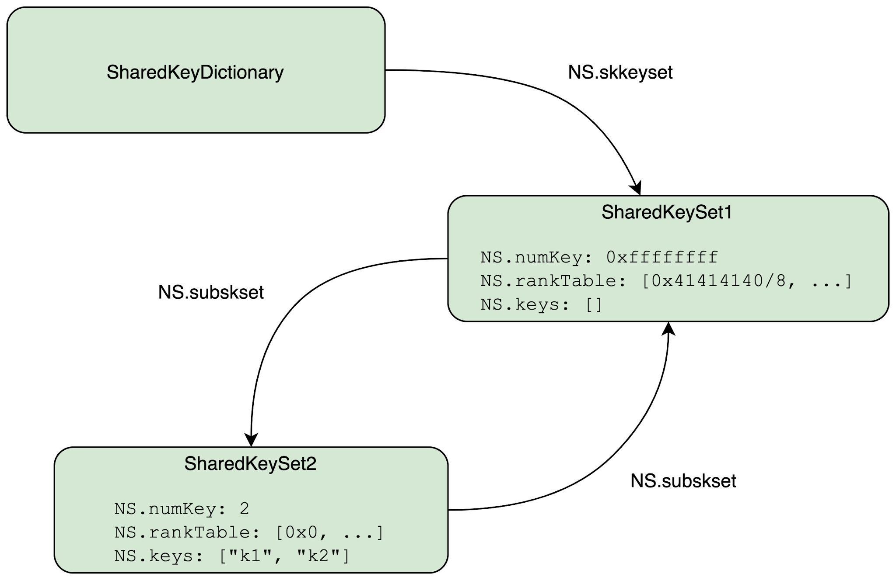
iMessage NSUnarchive Deserialization CVE-2019-8646
Memory Corruption
The NSSharedKeyDictionary is unarchived, in turn unarchiving its SharedKeySet
SharedKeySet1’s initWithCoder runs up to the point where it unarchives its subSharedKeySet (line 6).
_numKey is fully controlled by the attacker as no check has been performed on it yet
_rankTable is also fully controlled
_keys is still nullptr (as ObjC objects are allocated via calloc)
SharedKeySet2 is completely unarchived. Its subSharedKeySet is now a reference to SharedKeySet1
(which is still being unarchived). At the end, it invokes indexForKey: for all keys in its _keys array
As SharedKeySet2’s rankTable is all zeros, only the first key can be looked up on itself.
The second key will then be looked up on SharedKeySet1. Here, as
_numKey and _rankTable’s content are fully controlled,
the code will, in line 10, index into _keys causing a crash.
As a result of this, a mostly arbitrary address is now dereferenced and the result used as an ObjC object pointer (an “id”).

Slide 37
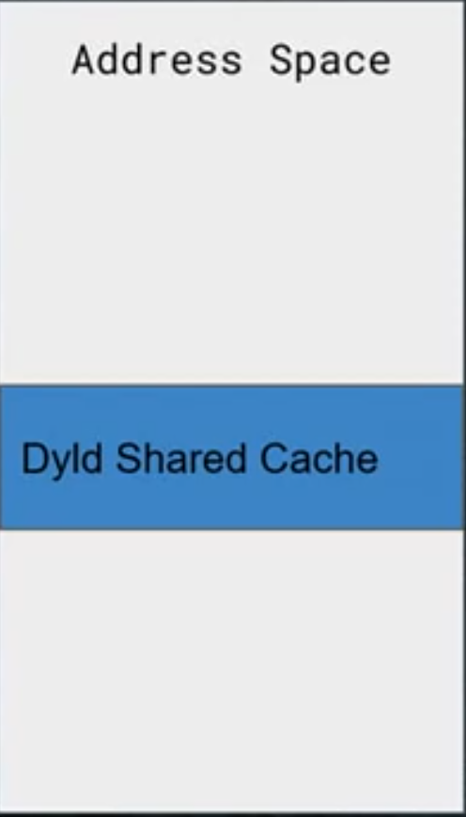
Defeating ASLR
Constant address of Dyld shared cache
Construct payload to dereference a given address
Send payload over iMessage
Got a delivery receipt: if yes, address is valid otherwise not
Repeat this process to perform binary search to find base address

Slide 38
Defeating Pointer Authentication (PAC)
Cryptographic signature in unused bits of pointer
Breaks ROP, JOP
Can be defeated through NSInvocation

Slide 39
Constant address of Dyld Shared Cache
Shared Cache re-sliding
Memory Corruption
ASLR Bypass
PAC Bypass
Unsandboxed Code Execution
Crash oracle via delivery receipts
Blastdoor
Crash oracle via delivery receipts
Heap Spraying
Crash oracle via delivery receipts
Exponential Throttling
Repeated Attempts
NSInvocation Hardening
Crash oracle via delivery receipts
Blastdoor Sandbox
Abuse NSInvocation
Crash oracle via delivery receipts

Slide 40
Blastdoor iOS 14
imagent
Re-architecture iMessage Processing
Complex parsing now happens inside a tight sandboxed process
High-level logic implemented in swift
Breaks the crash oracle
Blastdoor
imagent

Slide 41

Pegasus Forced Entry Exploit
one_loop.gif
infinite_loop.gif
... |  |  |  |  |  |  |  |  |  | ...
00000300 | 08 | 10 | 00 | 00 | 10 | 00 | 08 | 18 | |........| | 00000300 | 08 | 10 | 00 | 00 | 10 | 00 | 08 | 18 | |........|
00000308 | 00 | 08 | 00 | 00 | 00 | 21 | ff | 0b | |.....!..| | 00000308 | 00 | 08 | 00 | 00 | 00 | 21 | ff | 0b | |.....!..|
00000310 | 4e | 45 | 54 | 53 | 43 | 41 | 50 | 45 | |NETSCAPE| | 00000310 | 4e | 45 | 54 | 53 | 43 | 41 | 50 | 45 | |NETSCAPE|
00000318 | 32 | 2e | 30 | 03 | 01 | 01 | 00 | 00 | |2.0.....| | 00000318 | 32 | 2e | 30 | 03 | 01 | 00 | 00 | 00 | |2.0.....|
... |  |  |  |  |  |  |  |  |  | ...

Slide 42
Pegasus Forced Entry Exploit
Implementation of Infinite loop GIF edit in iMessage
[IMGIFUtils copyGifFromPath:toDestinationPath:error]
objc_msgSend(a1,
sel_readFileProperties_fromImageSource_withUpdatedLoopCount_error_, &v36,
v16,

Slide 43
Pegasus Forced Entry Exploit
20: IMSharedUtilities
19: IMSharedUtilities
18: IMSharedUtilities
17: ImageIO
16: ImageIO
15: ImageIO
14: ImageIO
13: ImageIO
12: CoreGraphics
11: CoreGraphics
10: CoreGraphics
9: CoreGraphics
8: CoreGraphics
7: CoreGraphics
6: CoreGraphics
5: CoreGraphics
4: CoreGraphics
3: CoreGraphics
2: CoreGraphics
1: CoreGraphics
0: CoreGraphics
copyGifFromPath:toDestinationPath:error: readFileProperties:fromImageSource:withUpdatedLoopCount:error: readFileProperties:fromImageSource:error:
_CGImageSourceCopyProperties IIOImageSource::copyProperties IIOImageSource::getProperties IIO_Reader_PDF::updateSourceProperties CreateSessionPDFRef
_CGPDFDocumentCreateWithProvider
_pdf_xref_create
_CGPDFXRefStreamCreate
_xref_stream_create
_xref_stream_read_section
_CGPDFSourceGetc
_CGPDFSourceRefill
_jbig2_filter_refill read_bytes JBIG2Stream::reset JBIG2Stream::readSegments
JBIG2Stream::readTextRegionSeg JBIG2Stream::readTextRegionSeg
Alter loop-count property of an animated GIF
iMessage
ImageIO
CoreGraphics
XPdf
process arbitrary JBIG2

Slide 44
Pegasus Forced Entry Exploit
JBIG2 Heap Overflow
Guint numSyms; numSyms = 0;
for (i = 0; i < nRefSegs; ++i) {
if ((seg = findSegment(refSegs[i]))) {
if (seg->getType() == jbig2SegSymbolDict) {
numSyms += ((JBIG2SymbolDict *)seg)->getSize();
}
// ...
}
// ...
syms = (JBIG2Bitmap **)gmallocn(numSyms, sizeof(JBIG2Bitmap *));

Slide 45
Pegasus Forced Entry Exploit
segments GList backing buffer
vtable
corruption
Guint segNum
int w
JBIG2Bitmap
int h
int line
Guchar* data

Slide 46
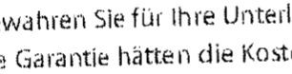




Pegasus Forced Entry Exploit
JBIG2 Compression

Slide 47
Pegasus Forced Entry Exploit
JBIG2 refinement operations
X
O
R
substituted
original
difference

Slide 48
Pegasus Forced Entry Exploit
JBIG2 refinement operations: Logic Gates
AND
OR
XOR
XNOR

Slide 49
Pegasus Forced Entry Exploit
JBIG2 refinement operations: ripple carry adder
A
AND
AND
^{C}in
OR
OR
^{C}out
B
AND
AND
A
XOR
XOR
^{C}in
XOR
XOR
Z
B

Slide 50
Pegasus Forced Entry Exploit
Unbounded memory access from JBIG2
Attack Surface: PDF/JBIG2 Parsing
Memory Corruption Bug
Run Exploit Logic in JBIG2 "VM" to bypass ASLR
Deserialize arbitrary ObjectiveC Objects through NSArchiver
Create NSExpression to bypass PAC
Implement "mini-CPU" from JBIG2 decompression operators
Code Execution in IMTranscoderAgent

Slide 51
Credits
Google Project Zero
Amnesty International
Citizen Lab
Lookout

Slide 52
Conclusion
The right mitigations/hardenings can make a big difference
Look out for hidden attack surface
Same old patch, patch and patch i.e. keep your OS and Apps updated
Reboot device, persistence is a pain for threat actors

